Slide 1
Introduction to Transaction Processing Concepts and Theory
Dr. Ejaz Ahmed
Read comments and additional details given with some slides

Slide 2
Outline
Introduction to transaction processing
Transaction and system concepts
Desirable properties of transactions
Schedules and recoverability
Schedules and Serializability
Transaction support in SQL
Summary

Slide 3
Introduction to Transaction Processing
Single-user VS multi-user systems
  A DBMS is single-user if at most one user can use the system at a time
  A DBMS is multi-user if many users can use the system concurrently
Problem
  How to make the simultaneous interactions of multiple users with the database safe, consistent, correct, and efficient?
Notes:
Consistent: All operations are managed ok without deadlock (indefinite loop of execution, e.g., stack overflow)
Transferring amount from one account to another; if ok then consistent otherwise inconsistent
baly=baly+400000
If baly is initially null or not initialized then final result is wrong
Means inconsistent state arises, means incorrect result can be produced

Slide 4
Concurrent Transactions
B
B
B
CPU₂
A
A
CPU₁
A
CPU₁
time
t₁
t₂
t₁
t₂
Interleaved processing
(Single processor)
Parallel processing
(Two or more processors)
Notes:
Timestamp: a digital record of the time of occurrence of a particular event. Or record the time with date

Slide 5
Transactions in General
Generally reflects the activities in the real world system
Depositing some amount in an account, will be a transaction
Transferring amount from one account to another; if ok then DB is in consistent state otherwise inconsistent.
One transaction can be calculating GPA in our exam system

Slide 6
What is a Transaction?
A transaction T is a logical unit of database processing that includes one or more database access operations
  Embedded within an application program
  Specified interactively (e.g., via SQL)
Transaction boundaries:
  Begin/end transaction
Types of transactions
  Read transaction
  write transaction
Read-set of T: all data items that transaction T reads
Write-set of T: all data items that transaction T writes

Slide 7
Role of Transactions
Transaction processing (TP) systems underlie the online applications. a transaction rate of 15 simple Debit Credit transactions per second was “common”, 50 TPS was a “good” system, 100 TPS was “fast”, and a 400 TPS system was characterized as being a very “lean and mean” system [24].
Teradata capabilities, usage of parallel databases, configuration and tuning etc.

Slide 8
A Transaction: An Informal Example
Transfer 400,000 from checking account to savings account
For a user it is one activity
To database:
  Read balance of checking account: read( X)
  Read balance of savings account: read (Y)
  Subtract 400,000 from X
  Add 400,000 to Y
  Write new value of X back to disk
  Write new value of Y back to disk

Slide 9
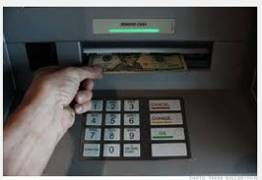
Transaction’s Example
Usage of ATM to draw money, to collect currency/ bills with dispenser
Notes:
x: balx=balx-400000
y: baly=baly+400000
If balx or baly is initially null then final result is wrong
Means inconsistent state arises, means incorrect result can be produced

Slide 10
Database Read and Write Operations
A database is represented as a collection of named data items
Read-item (X)
  Find the address of the disk block that contains item X
  Copy the disk block into a buffer in main memory
  Copy the item X from the buffer to the program variable named X
Write-item (X)
  Find the address of the disk block that contains item X.
  Copy that disk block into a buffer in main memory
  Copy item X from the program variable named X into its correct location in the buffer.
  Store the updated block from the buffer back to disk (either immediately or at some later point in time).

Slide 11
Oracle Data Block
At the finest level of granularity, Oracle stores data in data blocks (also called logical blocks, Oracle blocks, or pages). One data block corresponds to a specific number of bytes of physical database space on disk. You set the data block size for every Oracle database when you create the database. This data block size should be a multiple of the operating system's block size within the maximum limit. Oracle data blocks are the smallest units of storage that Oracle can use or allocate.
https://docs.oracle.com/cd/A57673_01/DOC/server/doc/SCN73/ch3.htm

Slide 12
A Transaction: A Formal Example
T1
read_item(X);
read_item(Y);
X:=X - 400000;
Y:=Y + 400000;
write _item(X);
write_item(Y);
t₀
t_{k}

Slide 13
Introduction to Transaction Processing…
Why concurrency control is needed?
Three problems are
  The lost update problem
  The temporary update (dirty read) problem
  Incorrect summary problem

Slide 14
Operations & Consistent States
Database Operation (read and write)
Non-database Operation (calculations/ formula)
Database Consistent State
Database Inconsistent State
data is available at particular time is called state
Chapter 17-<number>
Notes:
Consistent: All operations are managed ok without deadlock (indefinite loop of execution)
Transferring amount from one account to another; if ok then DB consistent otherwise inconsistent state

Slide 15
Concurrent Transaction
Concurrent transactions refer to two or more transactions that appear to users as they are being processed against a database at the same time
In reality, CPU can execute only one instruction at a time
  Transactions are interleaved meaning that the operating system quickly switches CPU services among tasks so that some portion of each of them is carried out in a given interval
Concurrency problems: lost update and inconsistent reads
9-<number>

Slide 16
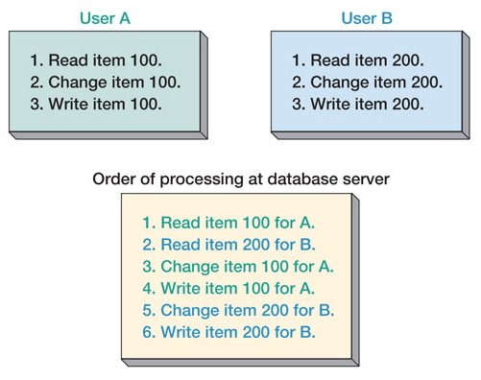
Concurrent Transaction Processing
9-<number>
Notes:
Item# is different
How to write Order of Processing in the form of formal writing of concurrent transaction

Slide 17
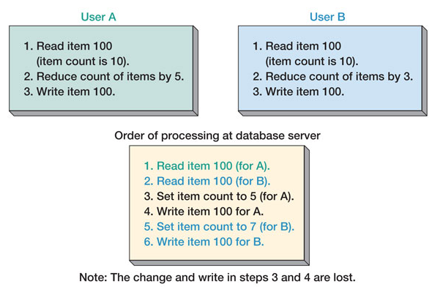
Lost-Update Problem
9-<number>
Notes:
Same Item# with its quantity update
How to write Order of Processing in the form of formal writing of concurrent transaction
A lost update occurs when two different transactions (concurrent) are trying to update the same column on the same row within a database at the same time. Typically, one transaction updates a particular column in a particular row, while another that began very shortly afterward did not see this update before updating the same value itself. The result of the first transaction is then "lost," as it is simply overwritten by the second transaction.

Slide 18
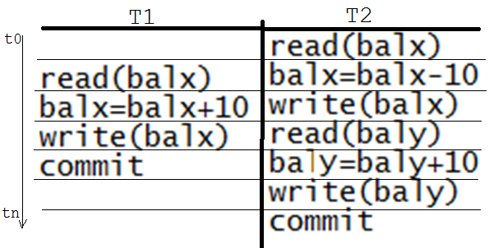
Transaction Example
$10 could be lost: inconsistent state
Transaction is committed or is aborted, DB is rollback or undo
Notes:
Write with commit is same as just write command

Slide 19
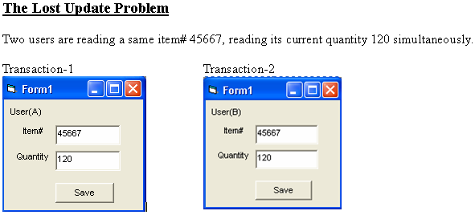
Two users are reading at the same time
9-<number>

Slide 20
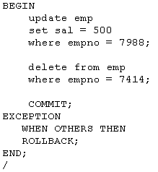
PL/SQL Transaction Example

Slide 21
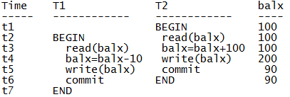
Example – The Lost Update Problem
Chapter 17-<number>

Slide 22
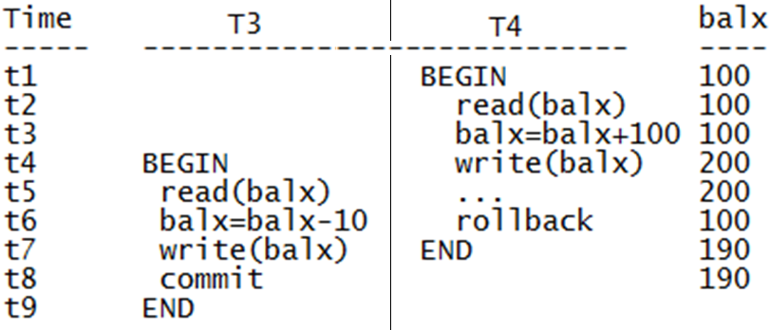
Some problems that occur when concurrent execution is uncontrolled.
(b) The temporary update problem (Dirty Read).
Notes:
In database systems, isolation determines how transaction integrity is visible to other users and systems. For example, when a user is creating a purchase order and has created the header, but not the purchase order lines, is the header available for other systems or users (carrying out concurrent operations, such as a report on purchase orders) to see?
A lower isolation level increases the ability of many users to access the same data at the same time, but increases the number of concurrency effects (such as dirty reads or lost updates) users might encounter. Conversely, a higher isolation level reduces the types of concurrency effects that users may encounter, but requires more system resources and increases the chances that one transaction will block another

Slide 23

FIGURE 17.2
Two sample transactions.
(a) Transaction T₁.
(b) Transaction T₂.

Slide 24
Lost Update Problem
time
T1
read_item(X);
X:=X - N;
write_item(X);
read_item(Y);
Y:=Y + N;
write_item(Y);
T2
read_item(X);
X:=X+M;
write_item(X);
Concurrent transactions T1, T2

Slide 25
Temporary Update (Dirty Read)
time
T1
read_item(X);
X:=X - N;
write_item(X);
read_item(Y);
T1 fails and aborts
T2
read_item(X);
X:=X+M;
write_item(X);
Concurrent transactions T1, T2

Slide 26
Incorrect Summary Problem
T1
read_item(X);
X:=X-N;
write_item(X);
read_item(Y);
Y=Y+N
Write_item(Y)
T3
sum:=0;
read_item(A);
sum:=sum+A;
read_item(X);
sum:=sum+X;
read_item(Y);
sum:=sum+Y
time
Concurrent transactions T1, T2
Notes:
If one transaction is calculating an aggregate summary function on a number of records while other transactions are updating some of these recods, the aggregate function may calculate some values before they are updated and others after they are updated

Slide 27
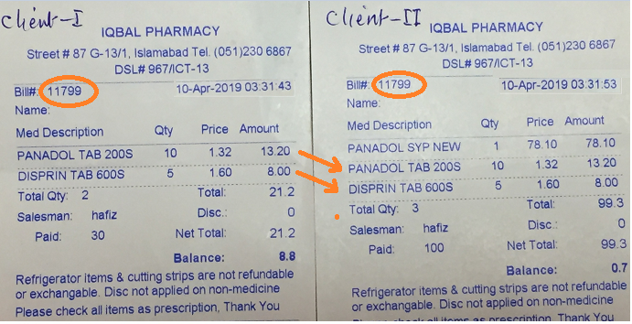
Inconsistent & Incorrect Results
Reading Bill# at the same time by both clients
Notes:
One is submitting after few seconds on same Bill#. Over writing issue is raised.

Slide 28
What Can Go Wrong?
System may crash before data is written back to disk
  Problem of atomicity
Some transaction is modifying shared data while another transaction is ongoing (or vice versa)
  Problem of serialization and isolation
System may not be able to obtain one or more of the data items
System may not be able to write one or more of the data items
  Problems of atomicity
DBMS has a Concurrency Control subsytem to assure database remains in consistent state despite concurrent execution of transactions

Slide 29
Other Problems
System failures may occur
  Types of failures:
    System crash
    Transaction or system error
    Local errors
    Concurrency control enforcement
    Disk failure
    Physical failures
DBMS has a Recovery Subsystem to protect database against system failures

Slide 30
Introduction to Transaction Processing (Cont.)
Why recovery is needed?
  A computer failure (system crash)
  A transaction or system error
  Local errors or exception conditions detected by the transaction
  Concurrency control enforcement
  Disk failure
  Physical problems and catastrophes

Slide 31
Transaction and System Concepts
Transaction states
BEGIN_TRANSACTION: marks start of transaction
READ or WRITE: two possible operations on the data
END_TRANSACTION: marks the end of the read or write operations; start checking whether everything went according to plan
COMMIT_TRANSACTION: signals successful end of transaction; changes can be “committed” to DB
  Partially committed
ROLLBACK (or ABORT): signals unsuccessful end of transaction, changes applied to DB must be undone

Slide 32
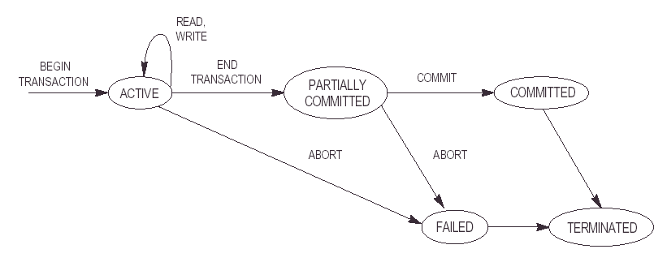
Transaction States: A state transition diagram

Slide 33
The System Log
Transaction –id
System log
  Multiple record-type file
  Log is kept on disk
  Periodically backed up
Log records
  [start_transaction, T]
  [write_item, T,X,old_value,new_value]:
  [read_item, T,X]
  [commit,T]
  [abort,T]
  [checkpoint]
Commit point of a transaction

Slide 34
How is the Log File Used?
All permanent changes to data are recorded
  Possible to undo changes to data
After crash, search log backwards until find last checkpoint
  Know that beyond this point, effects of transaction are permanently recorded
Need to either redo or undo everything that happened since last checkpoint
  Undo: When transaction only partially completed (before crash)
  Redo: Transaction completed but we are unsure whether data was written to disk

Slide 35
Example of a Transaction Log
TransID Table RowID column Before After
------- --------- ------ ------- ------ ------
100 **start**
100 EMPLOYEE 1005472 Salary 8000 8250
100 PROJECT 1423PRJ PrjRate 253 256
100 **end committed**
Database Auditing …
Chapter 17-<number>

Slide 36
Checkpoints
The point of synchronization between the database and the transaction log file is called checkpoint.
Database recovery is performed using transaction log.
How far to go back in the transaction log to search in case of failure.
Redoing transactions which are already Written to database – Time consuming & wasteful.
To find a point before which transactions are done correctly and safely – checking point
In checkpoint technique, all buffers are force written to secondary storage.

Slide 37
Checkpoint technique ...
Is used to limit
  the volume of log information
  amount of searching and
  subsequent processing that is needed to carry out on the transaction log file.
  Forcing a Checkpoint: Example The following statement forces a checkpoint:
  ALTER SYSTEM CHECKPOINT;
  Enabling Resource Limits: Example This ALTER SYSTEM statement dynamically enables resource limits:
  ALTER SYSTEM SET RESOURCE_LIMIT = TRUE;
Notes:
To execute commands, user is sys / as sysdba in oracle
A data structure that indicates the checkpoint position, which is the SCN (Oracle) in the redo stream where instance recovery must begin
System Change Number (SCN). A database ordering primitive. The value of an SCN is the logical point in time at which changes are made to a database.
select dbms_flashback.get_system_change_number from dual;
File: SCN & Checkpoints

Slide 38
Desirable Properties of Transactions
ACID properties
  Atomicity
  A transaction is an atomic unit of processing; it is either
  performed in its entirety or not performed at all.
  Consistency preservation
  A transaction is consistency preserving if its complete execution takes the database from one consistent state to another
  Isolation
  The execution of a transaction should not be interfered with by any other transactions executing concurrently
  Durability
  The changes applied to the database by a committed transaction must persist in the database. These changes must not be lost because of any failure

Slide 39
Desirable Properties of Transactions …
Atomicity
  Responsibility of transaction processing and recovery subsystems of the DBMS
Consistency
  Preservation of consistency is the responsibility of programmers
  Each transaction is assumed to take database from one consistent state to another consistent state
Isolation
  Enforced by the concurrency control subsystem of the DBMS
Durability
  Responsibility of the recovery subsystems of the DBMS

Slide 40
Transaction Processing
We have discussed that
  Multiple transactions can be executed concurrently by interleaving their operations
Schedule
  Ordering of execution of operations from various transactions T₁, T₂, … , T_{n} is called a schedule S

Slide 41
Schedules and Recoverability
Definition of Schedule (or history)
Schedule S of n transactions T₁, T₂, … , T_{n} is an ordering of the operations of the transactions subject to the constraint that, for each transaction T_{i} that participates in S, the operations of T_{i} in S must appear in the same order in which they occur in T_{i}.

Slide 42
Example of a Schedule
Transaction T₁: r₁(X); w₁(X); r₁(Y); w₁(Y); c₁
Transaction T₂: r₂(X); w₂(X); c₂
A schedule, S:
r₁(X); r₂(X); w₁(X); r₁(Y); w₂(X); w₁(Y); c₁; c₂
Notes:
Execution of two or more concurrent or serial transactions is called schedule

Slide 43
Conflicts
Two operations conflict if they satisfy ALL three conditions:
  they belong to different transactions AND
  they access the same item AND
  at least one is a write_item()operation
Example.:
  S: r₁(X); r₂(X); w₁(X); r₁(Y); w₂(X); w₁(Y);
conflicts
Notes:
Conflicts: RW, WW on same variable in two or more schedules
Conflict operations can creates inconsistency

Slide 44
Schedules of Transactions
Complete schedule
A schedule S of n transactions T₁, T₂, ..., T_{n} , is said to be a complete schedule if the following conditions hold:
  The operations in S are exactly those operations in T₁, T₂, ..., T_{n} including a commit or abort operation as the last operation for each transaction in the schedule.
  For any pair of operations from the same transaction T_{i} , their order of appearance in S is the same as their order of appearance in T_{i}.
  For any two conflicting operations, one of the two must occur before the other in the schedule

Slide 45
Serializability of Schedules
Serial Schedule
Non-serial schedule
Serializable schedule
  Conflict-serializable schedule
  View-serializable schedule

Slide 46
Serial Schedule
Serial schedule is guaranteed correct, should we adopt it?
No, that will be inefficient, under the utilization of resources
Dislike by the users
Notes:
User has to wait for unreleased or wait to finish first executed transaction

Slide 47
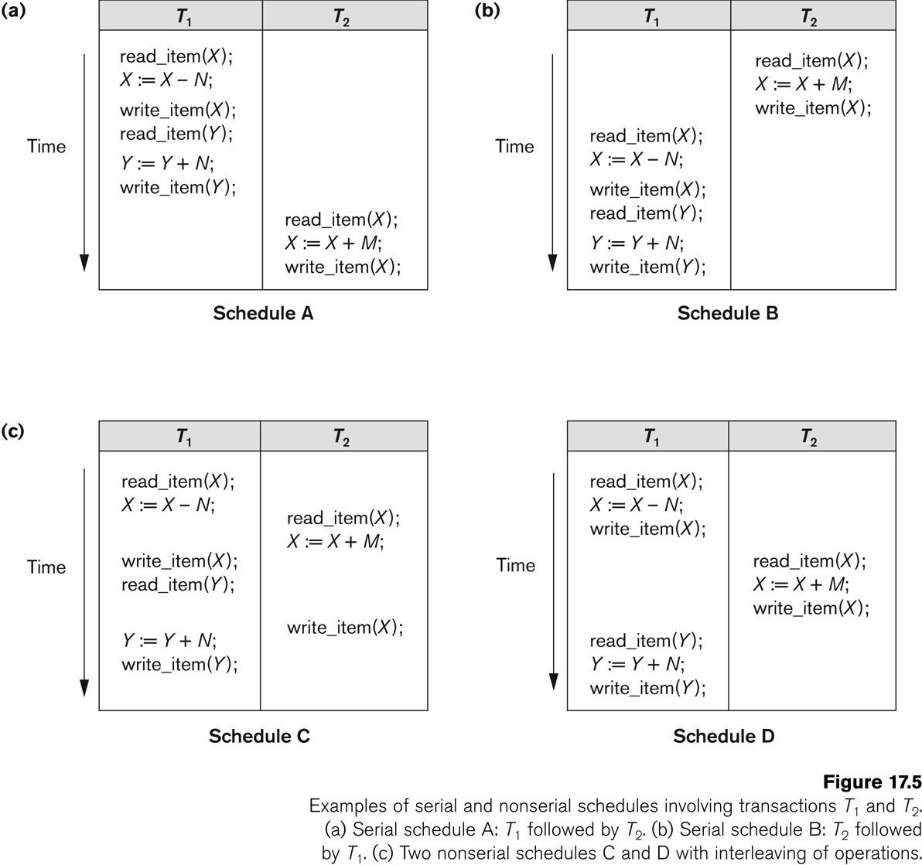

Slide 48
Serializability of Schedules …
Serial and Nonserial schedule
A schedule S is serial if, for every transaction T participating in the schedule, all the operations of T are executed consecutively in the schedule; otherwise, the schedule is called nonserial
Serializable schedule
A schedule S of n transactions is serializable if it is equivalent to some serial schedule of the same n transactions

Slide 49
Serial Schedule
We consider transactions to be independent, so serial schedule is correct
  Based on C property in ACID
Furthermore, it does not matter which transaction is executed first, as long as every transaction is executed in its entirety, from beginning to end
Example
  Assume X=90, Y=90, N=3, M=2, then result of schedule S is X=89 and Y= 93
  Same result if we start with T2

Slide 50
Why Do We Interleave Transactions?
Schedule S
T1
read_item(X);
X:=X-N;
write_item(X);
read_item(Y);
Y:=Y+N;
write_item(Y);
T2
read_item(X):
X:=X+M;
write_item(X);
Could be a long wait
S is a serial schedule – no interleaving!

Slide 51
Another Schedule
Schedule S’
T1
read_item(X);
X:=X-N;
write_item(X);
read_item(Y);
Y:=Y+N;
write_item(Y);
T2
read_item(X):
X:=X+M;
write_item(X);
S’ is a non-serial schedule
T2 will be done faster but is the result correct?

Slide 52
Concurrent Executions
Serial execution is by far simplest method to execute transactions
  No extra work ensuring consistency
Inefficient!
Reasons for concurrency:
  Increased throughput
  Reduces average response time
Need concept of correct concurrent execution
  Using same X, Y, N, M values as before, result of S’ is X=92 and Y=93 (not correct)

Slide 53
Yet Another Schedule
Schedule S”
T1
read_item(X);
X:=X-N;
write_item(X);
read_item(Y);
Y:=Y+N;
write_item(Y);
T2
read_item(X):
X:=X+M;
write_item(X);
S” is a non-serial schedule
Produces same result as serial schedule S

Slide 54
Serializability
Assumption: Every serial schedule is correct
Goal: Find non-serial schedules which are also correct
A schedule S of n transactions is serializable if it is equivalent to some serial schedule of the same n transactions
When are two schedules equivalent?
Option 1: They lead to same result (result equivalent)
Option 2: The order of any two conflicting operations is the same (conflict equivalent)

Slide 55
Result Equivalent Schedules
Two schedules are result equivalent if they produce the same final state of the database
Problem: May produce same result by accident!
S1
read_item(X);
X:=X+10;
write_item(X);
S2
read_item(X);
X:=X*1.1;
write_item(X);
Schedules S1 and S2 are result equivalent for X=100 but not in general

Slide 56
Conflict Equivalent Schedules
Two schedules are conflict equivalent, if the order of any two conflicting operations is the same in both schedules

Slide 57
Conflict Equivalence
Serial Schedule S1
T1
read_item(A);
write_item(A);
read_item(B);
write_item(B);
T2
read_item(A):
write_item(A);
read_item(B);
write_item(B);
order doesn’t matter
order matters
order matters
order
doesn’t matter

Slide 58
Conflict Equivalence
Schedule S1’
T1
read_item(A);
read_item(B);
write_item(A);
write_item(B);
T2
read_item(A):
write_item(A);
read_item(B);
write_item(B);
same order as in S1
same order as in S1
S1 and S1’ are conflict equivalent
(S1’ produces the same result as S1)

Slide 59
Conflict Equivalence
Schedule S1’’
T1
read_item(A);
write_item(A);
read_item(B);
write_item(B);
T2
read_item(A):
write_item(A);
read_item(B);
write_item(B);
different order than in S1
different order than in S1
Schedule S1’’ is not conflict equivalent to S1
(produces a different result than S1)
Notes:
It is from T2→T1

Slide 60
Conflict Serializable
Schedule S is conflict serializable if it is conflict equivalent to some serial schedule S’
  We can reorder the non-conflicting operations to improve efficiency
Non-conflicting operations:
  Reads and writes from same transaction
  Reads from different transactions
  Reads and writes from different transactions on different data items
Conflicting operations:
  Reads and writes from different transactions on same data item

Slide 61
Example
Schedule A
Schedule B
T1
read_item(X);
X:=X-N;
write_item(X);
read_item(Y);
Y:=Y+N;
write_item(Y);
T2
read_item(X);
X:=X+M;
write_item(X);
T1
read_item(X);
X:=X-N;
write_item(X);
read_item(Y);
Y:=Y+N;
write_item(Y);
T2
read_item(X);
X:=X+M;
write_item(X);
B is conflict equivalent to A ⇒ B is conflict serializable

Slide 62
Test for Serializability
Construct a directed graph, precedence graph, G = (V, E)
  V: set of all transactions participating in schedule
  E: set of edges T_{i} → T_{j} for which one of the following holds:
    T_{i} executes a write_item(X) before T_{j} executes read_item(X)
    T_{i} executes a read_item(X) before T_{j} executes write_item(X)
    T_{i} executes a write_item(X) before T_{j} executes write_item(X)
An edge T_{i} → T_{j} means that in any serial schedule equivalent to S, T_{i} must come before T_{j}
If G has a cycle, than S is not conflict serializable
If not, use topological sort to obtain serialiazable schedule (linear order consistent with precedence order of graph)
Notes:
To check consistency if graph is acyclic otherwise schedule has deadlock means inconsistent

Slide 63
Sample Schedule S
T1
read_item(X);
write_item(X);
read_item(Y);
write_item(Y);
T2
read_item(Z);
read_item(Y);
write_item(Y);
read_item(X);
write_item(X);
T3
read_item(Y);
read_item(Z);
write_item(Y);
write_item(Z);

Slide 64
Precedence Graph for S
X,Y
T1
T2
Y
Y,Z
no cycles ⇒ S is serializable
T3
Equivalent Serial Schedule:
T3 → T1 → T2
(precedence order)

Slide 65
Exercise – Testing Serializability
T1
read_item(Z);
read_item(X);
write_item(X);
read_item(Y);
write_item(Y);
T2
write_item(Z);
read_item(Y);
write_item(Y);
read_item(X);
write_item(X);
T3
read_item(Y);
read_item(Z);
write_item(Y);
write_item(Z);

Slide 66
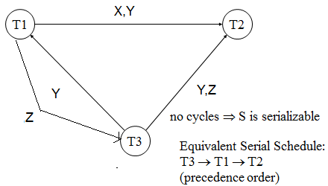
Precedence Graph for S

Slide 67
Characterizing Schedules based on Serializability
Being serializable is not the same as being serial
Being serializable implies that the schedule is a correct schedule.
  It will leave the database in a consistent state.
  The interleaving is appropriate and will result in a state as if the transactions were serially executed, yet will achieve efficiency due to concurrent execution.

Slide 68
Characterizing Schedules based on Serializability
Serializability is hard to check.
  Interleaving of operations occurs in an operating system through some scheduler
  Difficult to determine before hand how the operations in a schedule will be interleaved.

Slide 69
Characterizing Schedules based on Serializability
Practical approach:
Come up with methods (protocols) to ensure serializability.
It’s not possible to determine when a schedule begins and when it ends. Hence, we reduce the problem of checking the whole schedule to checking only a committed project of the schedule (i.e. operations from only the committed transactions.)
Current approach used in most DBMSs:
  Concurrency control techniques
  Examples
    Two-phase locking technique
    Timestamp ordering technique

Slide 70
Reading Assignments
Read Next slides (Self study)

Slide 71
Characterizing Schedules based on Serializability
View equivalence: A less restrictive definition of equivalence of schedules
View serializability
  Definition of serializability based on view equivalence.
A schedule is view serializable if it is view equivalent to a serial schedule.

Slide 72
Characterizing Schedules based on Serializability
Two schedules are said to be view equivalent if the following three conditions hold:
The same set of transactions participates in S and S’, and S and S’ include the same operations of those transactions.
For any operation R_{i}(X) of T_{i} in S, if the value of X read by the operation has been written by an operation W_{j}(X) of T_{j} (or if it is the original value of X before the schedule started), the same condition must hold for the value of X read by operation R_{i}(X) of T_{i} in S’.
If the operation W_{k}(Y) of T_{k} is the last operation to write item Y in S, then W_{k}(Y) of T_{k} must also be the last operation to write item Y in S’.

Slide 73
Characterizing Schedules based on Serializability
The premise behind view equivalence:
As long as each read operation of a transaction reads the result of the same write operation in both schedules, the write operations of each transaction must produce the same results.
“The view”: the read operations are said to see the the same view in both schedules.

Slide 74
Characterizing Schedules based on Serializability
Relationship between view and conflict equivalence:
The two are same under constrained write assumption which assumes that if T writes X, it is constrained by the value of X it read; i.e., new X = f(old X)
Conflict serializability is stricter than view serializability. With unconstrained write (or blind write), a schedule that is view serializable is not necessarily conflict serializable.
Any conflict serializable schedule is also view serializable, but not vice versa.

Slide 75
Characterizing Schedules based on Serializability
Relationship between view and conflict equivalence (cont):
Consider the following schedule of three transactions
T1: r1(X), w1(X); T2: w2(X); and T3: w3(X):
Schedule Sa: r1(X); w2(X); w1(X); w3(X); c1; c2; c3;
In Sa, the operations w2(X) and w3(X) are blind writes, since T1 and T3 do not read the value of X.
Sa is view serializable, since it is view equivalent to the serial schedule T1, T2, T3. However, Sa is not conflict serializable, since it is not conflict equivalent to any serial schedule.

Slide 76
Transaction Support in SQL
A single SQL statement is always considered to be atomic
There is no explicit Begin_Transaction statement
SET TRANSACTION statement in SQL2 sets the characteristics of a transaction
  Access mode
    READ only or READ-WRITE
  Diagnostic area size
    Indicates the number of conditions that can be held simultaneously in the diagnostic area.
  Isolation level
    READ UNCOMMITTED, READ COMMITTED, REPEATABLE READ, SERIALIZABLE

Slide 77
Isolation Level | Type of Violation
 | Dirty READ | Non-Repeatable READ | Phantom
READ UNCOMMITTED | Yes | Yes | Yes
READ COMMITTED | No | Yes | Yes
REPEATABLE READ | No | No | Yes
SERIALIZABLE | No | No | No

Slide 78
Applying Locking
An Object is locked before it performs any operation
Two types of operations, two types of locks
Shared & Exclusive Locks

Slide 79
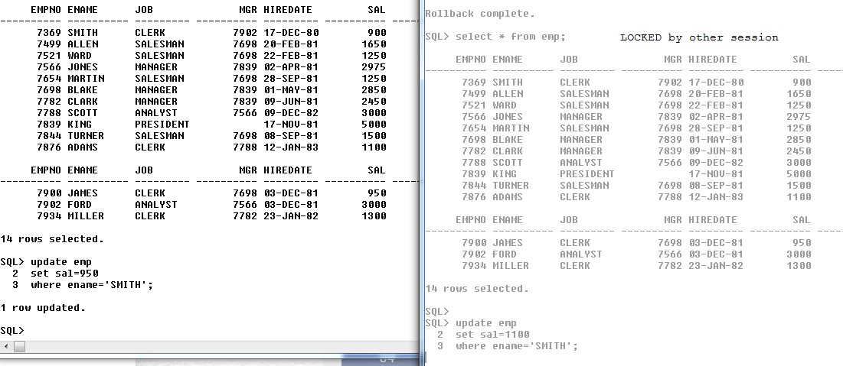
Locks in Oracle SQL
Record level lock/ Row Lock – same record

Slide 80
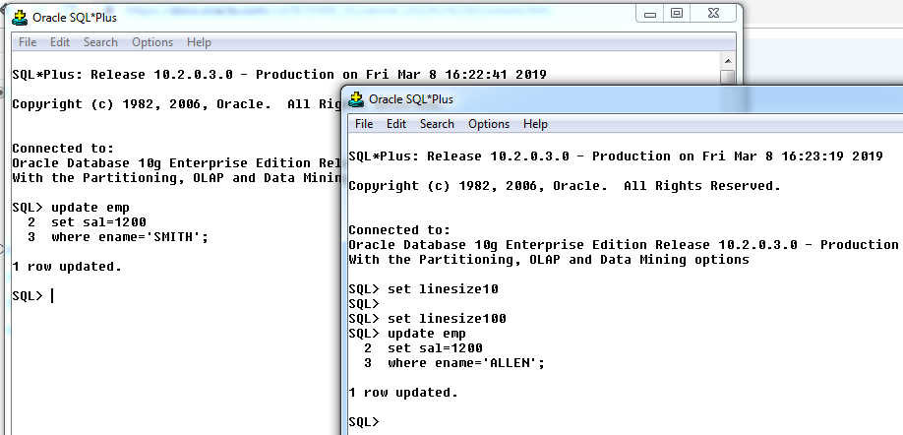
Different Records updates

Slide 81
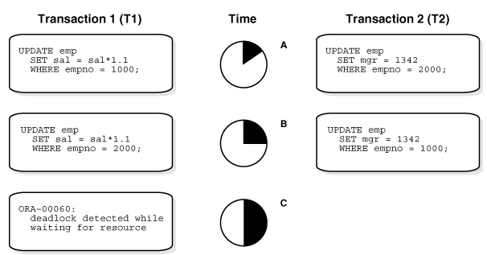
Deadlock – TWO Transactions

Slide 82
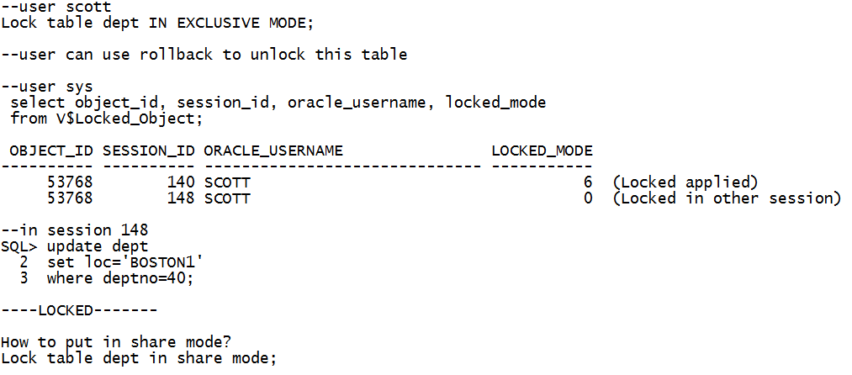
Applying locks at Table Levels

Slide 83
Deadlock
Deadlock is a situation when two transaction are waiting for each other to release a lock
The transactions involved in deadloack keep on waiting unless deadlock is over
Notes:
Identify victim transaction and kill it to release deadlock
Locks are applied in Growing phase of transaction.
If transaction releases only one lock then this phase is called shrinking phases
and no further locks are applied then this is called 2PL. Growing & Shrinking phases are two phase Locking (2PL).

Slide 84
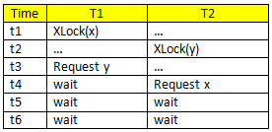
Deadlock

Slide 85
Summary
Introduction to transaction processing
Transaction and system concepts
Desirable properties of transactions
Schedules and recoverability
Serializability of schedules
Transaction support in SQL
Thank you

